Slide 1
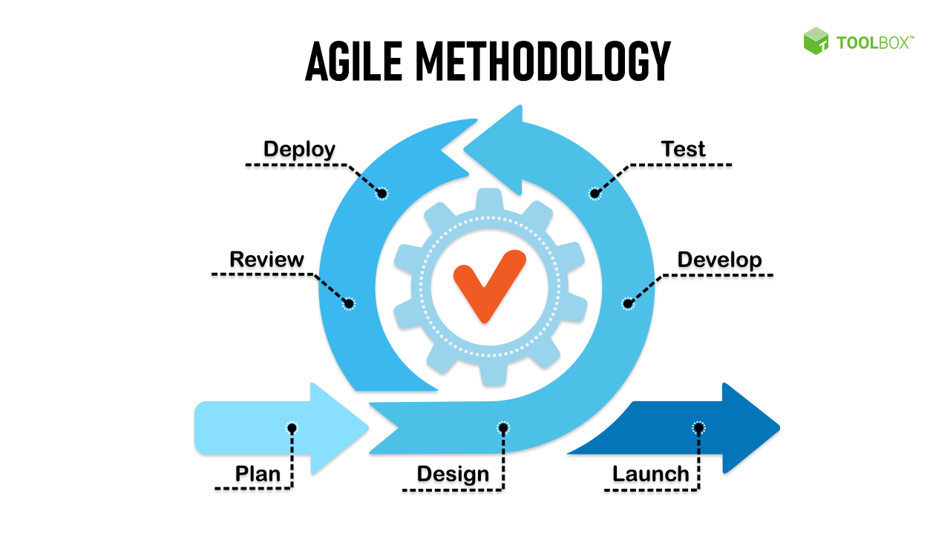
Agile Methodologies
Agile methodologies are a set of flexible and iterative approaches to software development and project management

Slide 2
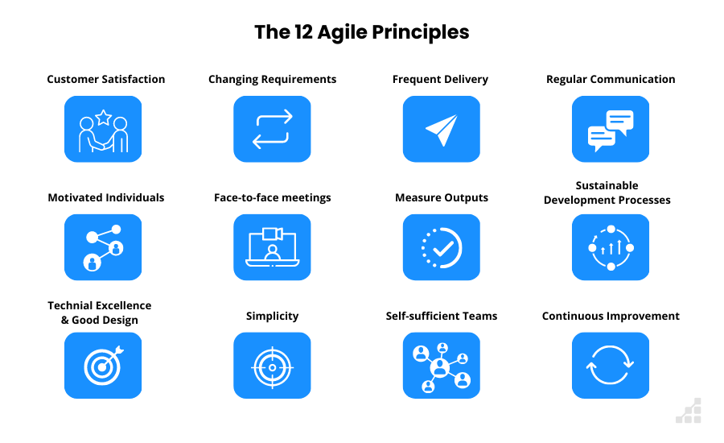
Agile Principles

Slide 3
Agile methodology frameworks
Agile Manifesto
Scrum
Crystal
Kanban
Extreme Programming (XP)
Lean Software Development
Feature-Driven Development (FDD)
Dynamic Systems Development Method (DSDM)

Slide 4
Sprint Planning
Sprint Planning is a Scrum framework
Scrum Team collaboratively plans the work to be done during the upcoming Sprint
Preparation
Sprint Planning Meeting
What Can Be Done (Capacity)
What Will Be Done (Selection)
Defining the Sprint Goal
Task Breakdown
Commitment
Sprint Backlog

Slide 5
Benefits of Agile
Flexibility and Adaptability
Faster Time-to-Market
Improved Quality
Transparency
Higher Productivity
Enhanced Risk Management
Continuous Improvement
Customer Satisfaction:

Slide 6
Resources
https://www.wrike.com/project-management-guide/agile-methodology-basics/
https://www.youtube.com/watch?v=WjwEh15M5Rw&t=491s
https://www.youtube.com/watch?v=g39DSL576Zs
https://www.youtube.com/watch?v=6fKn4rgk4jM

Slide 7
THANK YOU

